Slide 1

Project on
House Price Prediction
Presented by
Ganta Ganesh

Slide 2
Problem Statement
Problem Statement: Houses are one of the necessary need of each and every person around the globe and therefore housing and real estate market is one of the markets which is one of the major contributors in the world’s economy. It is a very large market and there are various companies working in the domain. Data science comes as a very important tool to solve problems in the domain to help the companies increase their overall revenue, profits, improving their marketing strategies and focusing on changing trends in house sales and purchases. Predictive modelling, Market mix modelling, recommendation systems are some of the machine learning techniques used for achieving the business goals for housing companies. Our problem is related to one such housing company. A US-based housing company named Surprise Housing has decided to enter the Australian market. The company uses data analytics to purchase houses at a price below their actual values and flip them at a higher price. For the same purpose, the company has collected a data set from the sale of houses in Australia. The data is provided in the CSV file below. The company is looking at prospective properties to buy houses to enter the market. You are required to build a model using Machine Learning in order to predict the actual value of the prospective properties and decide whether to invest in them or not.
For this company wants to know:
• Which variables are important to predict the price of variable?
• How do these variables describe the price of the house?

Slide 3
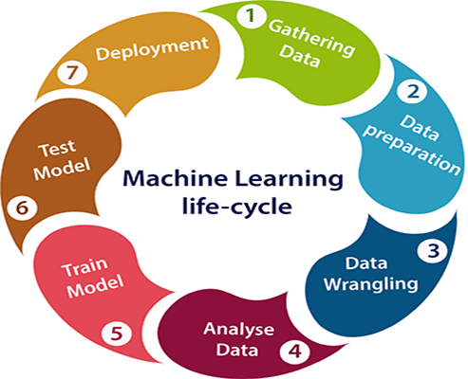
Steps Involved in Building Machine Learning Project
Gathering Data
Data Preparation
Data Wrangling
Analyze Data
Train the model
Test the model
Deployment

Slide 4
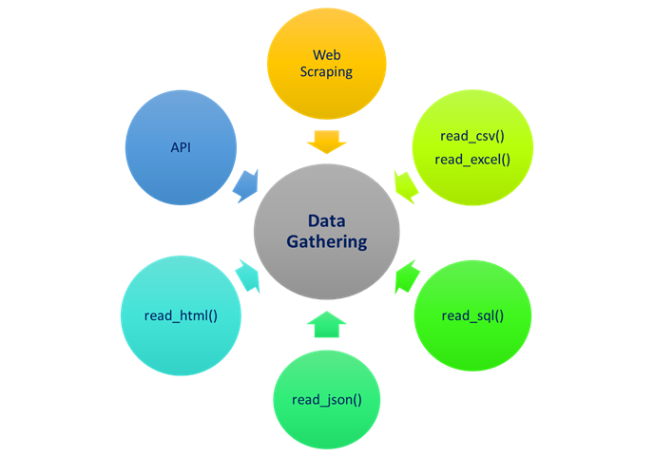
Gathering Data
In this step, we need to identify the different data sources, as data can be collected from various sources such as files, database, internet, or mobile devices.
In our project, we have collected the data from files through available resources and stored in our local storage.

Slide 5
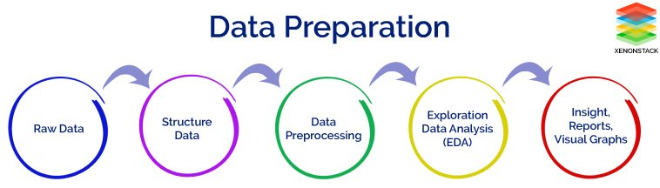
Data Preparation
After collecting the data, we need to prepare it for further steps. Data preparation is a step where we put our data into a suitable place and prepare it to use in our machine learning training.
This step can be further divided into two processes:
Data exploration: It is used to understand the nature of data that we have to work with. We need to understand the characteristics, format, and quality of data. A better understanding of data leads to an effective outcome. In this, we find Correlations, general trends, and outliers.
Data pre-processing: Now the next step is preprocessing of data for its analysis.

Slide 6
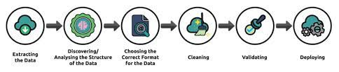
Data wrangling
Data wrangling is the process of cleaning and converting raw data into a useable format. It is the process of cleaning the data, selecting the variable to use, and transforming the data in a proper format to make it more suitable for analysis in the next step. It is one of the most important steps of the complete process. Cleaning of data is required to address the quality issues.
It is not necessary that data we have collected is always of our use as some of the data may not be useful. In real-world applications, collected data may have various issues, including:
Missing Values
Duplicate data
Invalid data
Noise
So, we use various filtering techniques to clean the data.
It is mandatory to detect and remove the above issues because it can negatively affect the quality of the outcome.

Slide 7
Analyze Data
Now the cleaned and prepared data is passed on to the analysis step. This step involves:
Selection of analytical techniques
Building models
Review the result
The aim of this step is to build a machine learning model to analyze the data using various analytical techniques and review the outcome. It starts with the determination of the type of the problems, where we select the machine learning techniques such as Classification, Regression, Cluster analysis, Association, etc. then build the model using prepared data, and evaluate the model.
In our project, we used principal component analysis to reduce dimensions in our dataset.

Slide 8
Lasso Regularization :
Lasso (Least Absolute Shrinkage and Selection Operator) regression is a regularized linear regression. It uses L1 norm to constrain the coefficients of the fitting model. Usually, some coefficients will be set to 0 under the constrain. Therefore, the lasso regression is more robust compared to ordinary linear regression.
Principal Component Analysis:
Principal Component Analysis is an unsupervised learning algorithm that is used for the dimensionality reduction in machine learning. It is a statistical process that converts the observations of correlated features into a set of linearly uncorrelated features with the help of orthogonal transformation. These new transformed features are called the Principal Components. It is one of the popular tools that is used for exploratory data analysis and predictive modeling. It is a technique to draw strong patterns from the given dataset by reducing the variances.
PCA generally tries to find the lower-dimensional surface to project the high-dimensional data.
PCA works by considering the variance of each attribute because the high attribute shows the good split between the classes, and hence it reduces the dimensionality.
It is a feature extraction technique, so it contains the important variables and drops the least important variable.

Slide 9
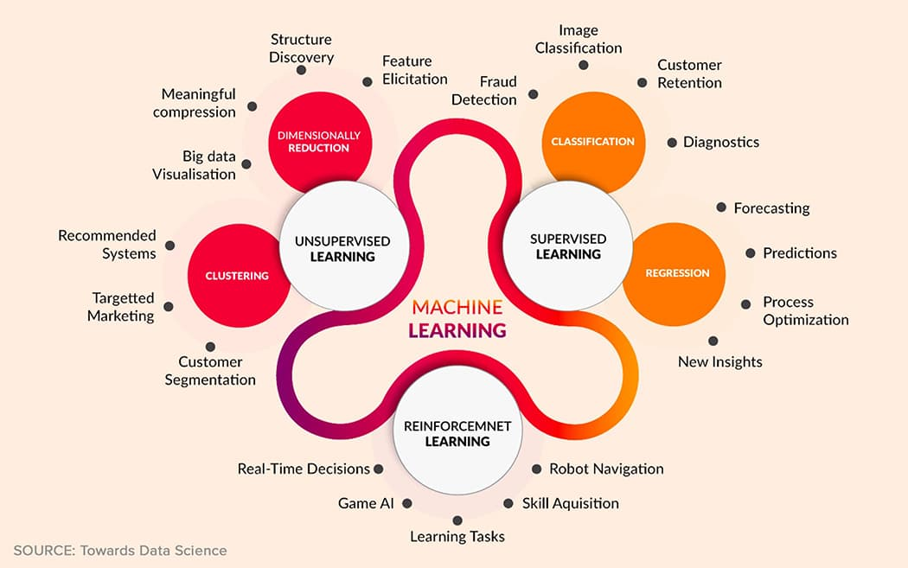
Model Building
We build our model using Classification Models.
Various classifications we used in model building are:
Linear Regression
Random Forest Regression
K Nearest Neighbors Model
Decision Tree Regressor

Slide 10
Linear Regression Model:
Linear regression is one of the easiest and most popular Machine Learning algorithms. It is a statistical method that is used for predictive analysis. Linear regression algorithm shows a linear relationship between a dependent (y) and one or more independent (y) variables, hence called as linear regression. Since linear regression shows the linear relationship, which means it finds how the value of the dependent variable is changing according to the value of the independent variable.
Random Forest Regression:
Random Forest Regression is a supervised learning algorithm that uses ensemble learning method for regression. Ensemble learning method is a technique that combines predictions from multiple machine learning algorithms to make a more accurate prediction than a single model. A Random Forest operates by constructing several decision trees during training time and outputting the mean of the classes as the prediction of all the trees.
k-Nearest Neighbors (KNN)
The k-nearest neighbors (KNN) algorithm is a simple, supervised machine learning algorithm that can be used to solve both classification and regression problems. It's easy to implement and understand, but has a major drawback of becoming significantly slows as the size of that data in use grows.
Decision Tree Regressor:
Decision tree builds regression or classification models in the form of a tree structure. It breaks down a dataset into smaller and smaller subsets while at the same time an associated decision tree is incrementally developed. The final result is a tree with decision nodes and leaf nodes. A decision node (e.g., Outlook) has two or more branches (e.g., Sunny, Overcast and Rainy), each representing values for the attribute tested. Leaf node (e.g., Hours Played) represents a decision on the numerical target. The topmost decision node in a tree which corresponds to the best predictor called root node. Decision trees can handle both categorical and numerical data.

Slide 11
Train Model
Now the next step is to train the model, in this step we train our model to improve its performance for better outcome of the problem.
We use datasets to train the model using various machine learning algorithms. Training a model is required so that it can understand the various patterns, rules, and, features.
Test Model
Once our machine learning model has been trained on a given dataset, then we test the model. In this step, we check for the accuracy of our model by providing a test dataset to it.
Testing the model determines the percentage accuracy of the model as per the requirement of project or problem.

Slide 12
𝑅^2 : It is a measure of the linear relationship between X and Y. It is interpreted as the proportion of the variance in the dependent variable that is predictable from the independent variable.
Adjusted 𝑅^2 :The adjusted R-squared compares the explanatory power of regression models that contain different numbers of predictors.
MAE : It is the mean of the absolute value of the errors. It measures the difference between two continuous variables, here actual and predicted values of y.
MSE: The mean square error (MSE) is just like the MAE, but squares the difference before summing them all instead of using the absolute value.
RMSE: The mean square error (MSE) is just like the MAE, but squares the difference before summing them all instead of using the absolute value.

Slide 13
Deployment
The last step of machine learning life cycle is deployment, where we deploy the model in the real-world system.
If the above-prepared model is producing an accurate result as per our requirement with acceptable speed, then we deploy the model in the real system. But before deploying the project, we will check whether it is improving its performance using available data or not. The deployment phase is similar to making the final report for a project.

Slide 14
THANK YOU

